Slide 1

Look Ma, No VM! Taking Azure Web Sites to the limit.
Aidan Ryan
Solutions Architect
AidanR@magenic.com
@ajryan
https://github.com/ajryan/notes-test

Slide 2
Agenda
What is Azure Web Sites?
When to choose Azure Web Sites
Creating a new site
Deployment
Site build out
Database + Web API
SignalR
Web Jobs
Debugging / Monitoring / Diagnostics
Scaling Options
Staged Deployment, Backup / Restore, Traffic Manager
https://github.com/ajryan/notes-test

Slide 3
What is Azure Web Sites?
Platform as a Service (PaaS)
AKA, a container for
ASP.NET
PHP
Node.js
Any FastCGI application
Supporting Facilities
Deployment
Scaling
Monitoring / Diagnostics
Web Jobs
Lots more…
Physical Machine
Virtual Machine
IIS
Virtual Directory

Slide 4






Web Sites
Virtual Machines

Slide 5
When to choose?
As often as possible for HTTP-land:
Sites
Web Services
Scheduled Jobs
Unless you hit a limitation:
Port needs / Firewall rules
Elevated permissions
Advanced networking (e.g. Azure Virtual Network)
Manage security certificates
Applications with an install footprint (SharePoint, BizTalk, etc)
>10GB, RDP, VPN
Very detailed rundown – Web Sites vs Web Roles:
Rod Daniel Moore blog post

Slide 6
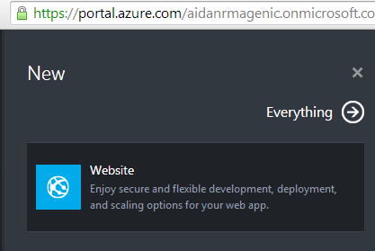
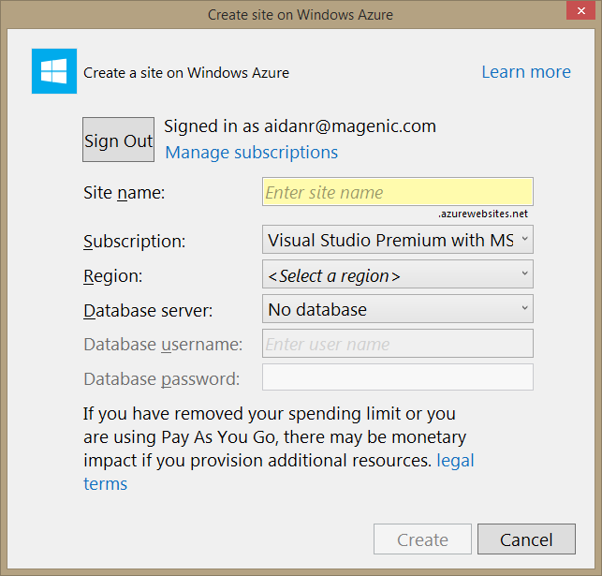
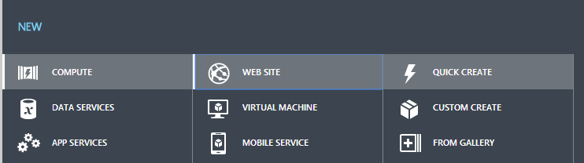
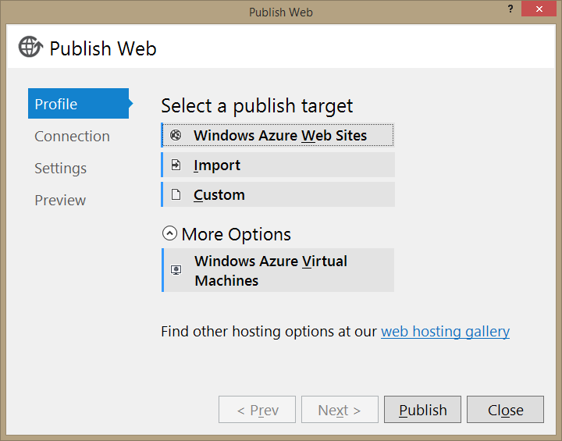
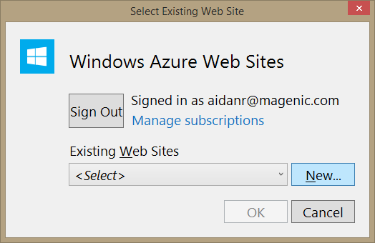
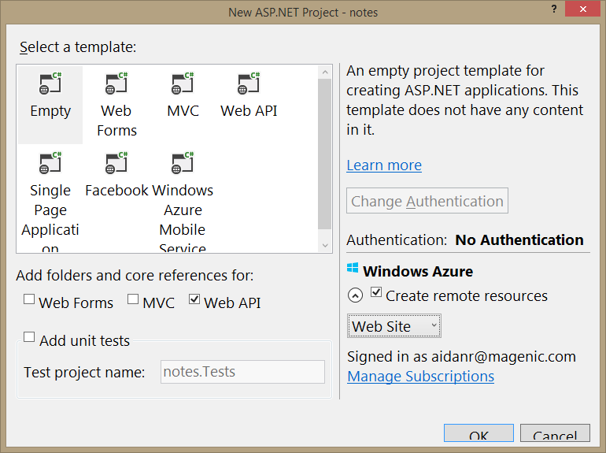
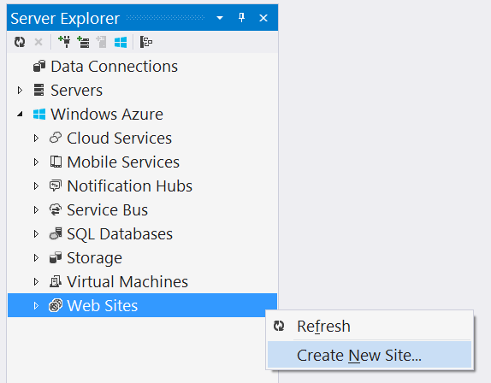
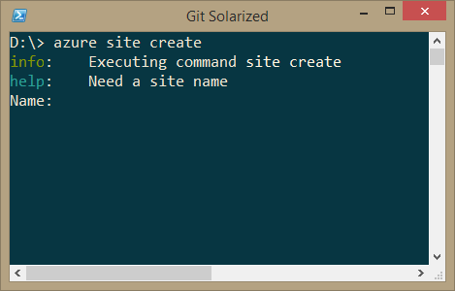
New Site Options

Slide 7
New Site Options
Visual Studio
Server Manager > Azure > Web Sites
File > New Project > “One ASP.NET” > Create remote resources
Right-click project > Publish
Azure Management Portals
manage.windowsazure.com
portal.azure.com
CLI
PowerShell CmdLets
Node CLI

Slide 8
Deployment Options
FTP
WebDeploy
Visual Studio Online (TFS)
GitHub / BitBucket / CodePlex
DropBox
Git Push
With a commit hook
To Azure repo

Slide 9
Creating/Deploying a new site: CLI
Visual Studio
Create initial project
GitHub:
Create repo
CLI:
Install the CLI tools (docs)
azure account download
azure account import
azure site create
azure site deployment github
Git:
git init
git add
git commit
git remote add
git push
Notes:
CLI tools are built on Node.js and work across all platforms it supports. They work against the Azure management APIs
CLI install options:
Download an installer (Windows or OS X) that wraps a private copy of node.exe and puts an azure.cmd on your path
If you have node/npm: “npm install azure-cli –global”
New “One ASP.NET” project
Web API references
Add index.htm
Github.com > new repo
Azure site create
Azure site deployment github --githubusername ajryan --githubrepository ajryan/notes
Copy .gitignore
HAVE THE PORTAL OPEN - Git init / commit / remote add / push -u

Slide 10
Site Build Out
Keep it warm! Application Insights, New Relic, Pingdom, Monitoring Endpoint etc…
Web API + Database
Some UI
SignalR
Web Job

Slide 11
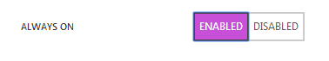
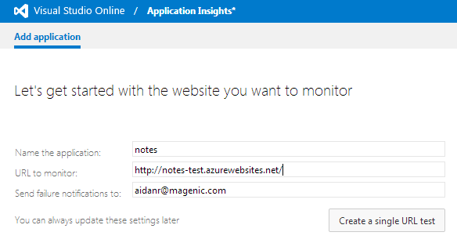

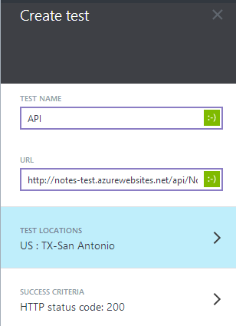


Keep It Warm
Notes:
Endpoint Monitoring (endpoint test) and Always On included only on Standard
Always On enable only in Manage portal so far

Slide 12
Web API + Database
New Project > “One ASP.NET” > any Web API option
It just works, it’s just HTTP
Database
SQL Azure: Free single instance under 20 MB
Sql Compact: 1GB total storage. DOES NOT SCALE OUT.
Notes:
DB/ Web API
Add a notes data type – [Key]ID, Title, Text
Nuget EntityFramework
Add class NotesContext: DbContext { public DbSet<Note> Notes { get; set; }
Add class NotesInitializer: CreateDatabaseIfNotExists<>, protected override void Seed
Global.asax.cs – Database.SetInitializer(new NotesInitializer())
Database options – SqlCE or Azure SQL
Web API
Right-click new controller > Web API 2 + actions + EF
Test with Advanced REST Client
UI
NuGet Angular
<script src angular
Add TypeScript /Scripts/index-ctrl.ts
<script src index-ctrl.js
DELETE TYPESCRIPTTOOLSVERSION FROM .csproj
COPY NEW INDEX, COPY NEW TYPESCRIPT

Slide 13
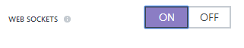
SignalR
NuGet Microsoft.AspNet.SignalR
Pulls in Client (JavaScript) and Server (ASP.NET Hub) dependencies
Include jQuery and SignalR (bump jQuery version for Angular compat)
Follow readme.txt instructions (Startup class)
Create a hub
Consume in JS
Enable WebSockets in Azure Portal
Notes:
Create a hub: inherit Hub
Public void AddNote(string note) { Client.Others.noteAdded(note) }
Comsume:
COPY FROM TEST…

Slide 14
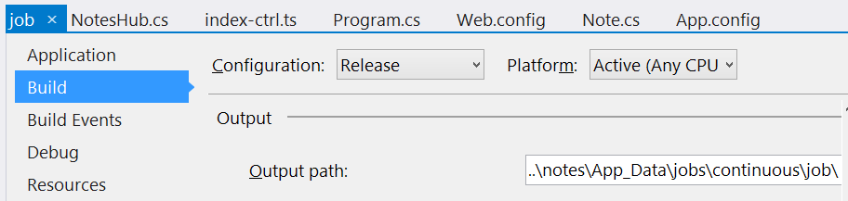
Web Jobs + Git Deploy
* Continuous only
Notes:
New console app
While (true)
Add SqlServerCompact for EF
Add model and context class as link
*** NOTE Environment.Currentdirectory is NOT same as deploy --- ***
Modify the context class – add ctor overload with path to data file - use the env WEB_ROOT variable
Loop and check for new notes… narrative is we can send email, etc…

Slide 15
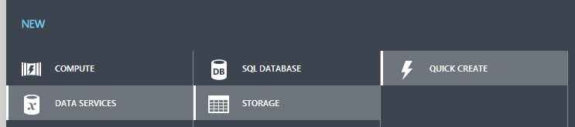
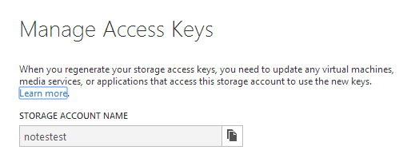
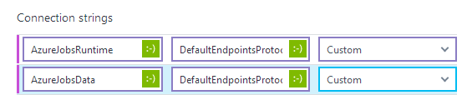
Web Jobs: Set Up Storage and Configure Connection
Queue primary key
Web site connection strings – Hide from GitHub!
Notes:
XXXXX --- FIX UP THIS SEQUENCE XXXXX – new queue, get the key, add conn string, use inside both projects…. XXXXX
Create a storage account
Get your primary access key
Add connection strings – IN THE PORTAL – HIDE FROM SOURCE CONTROL!

Slide 16
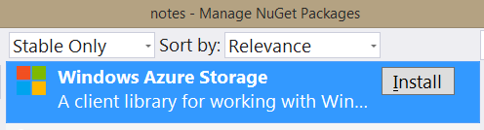
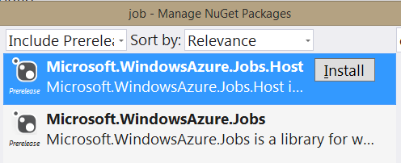
Web Jobs: Post/Consume Queue
Site side: create queue, post to it with CloudQueueClient
Job side: consume queue with [QueueInput] attribute
Notes:
Create a storage account
Get your primary access key
Add connection strings – IN THE PORTAL – HIDE FROM SOURCE CONTROL!
Add the MailGun stuff and send an SMS

Slide 17
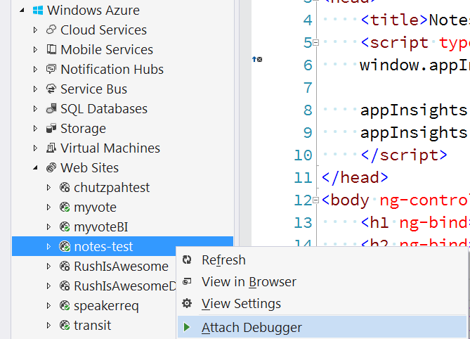
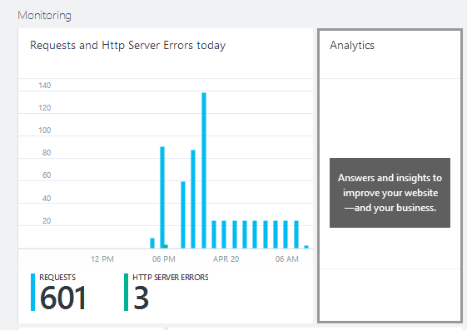
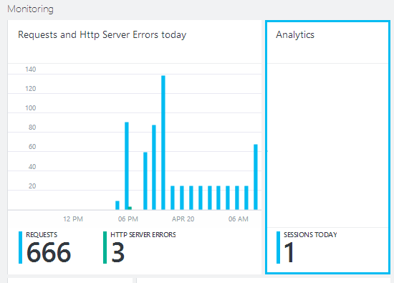
Debugging / Monitoring / Diagnostics
Notes:
Generate a deployment script so it builds in Debug
Azure site deploymentscript --aspWAP .\notes\notes.csproj -s .\notes.sln
Show Analytics from portal.azure.com – add script to head (like Google Analytics), revisit to see sessions
** if time, show from ajryan.visualstudio.com **

Slide 18
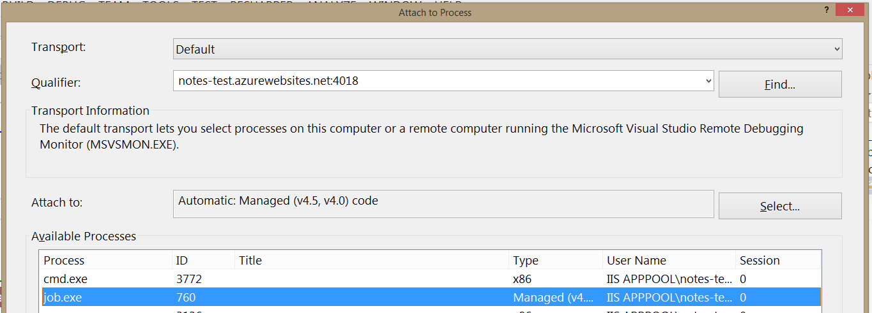
Debug a WebJob!

Slide 19
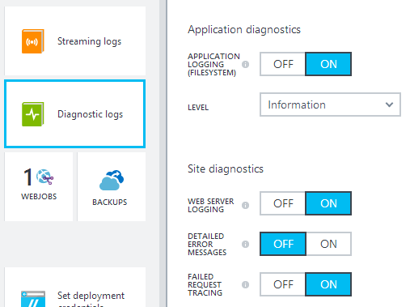
Additional Monitoring / Diag options
Monitor via Application Insights / New Relic / etc
Alert Rules
Management Services (manage) / Alerts on Site (portal)
Kudu log streaming
For Web API, NuGet Microsoft.AspNet.WebApi.Tracing
Visual Studio Server Explorer
azure site log tail [sitename]
Kudu Terminal
KuduExec
portal.azure.com
https://[site]. scm.azurewebsites.net/

Slide 20
Kudu Deployment Customization Example: Unit Tests
Generate base deployment script
azure site deploymentscript --aspWAP <csproj> -s <sln>
Add lines to
Build test project
Call vstest.console.exe and exit on error

Slide 21
Scaling: Tiers
 | Free | Shared | Basic (New) | Standard
Storage | 1GB | 1GB | 10GB | 50GB
CPU Cores | Shared |  | 1 / 2 / 4
RAM | Shared |  | 1.75GB / 3.5GB / 7GB
Custom Domains |  | Yes | Yes (with SSL) | Yes (with SSL)
Web Sockets | 5 concurrent | 35 concurrent | 350 concurrent | Unlimited
Staged Publishing |  |  |  | Yes
SLA |  |  | 99.9% | 99.9%

Slide 22
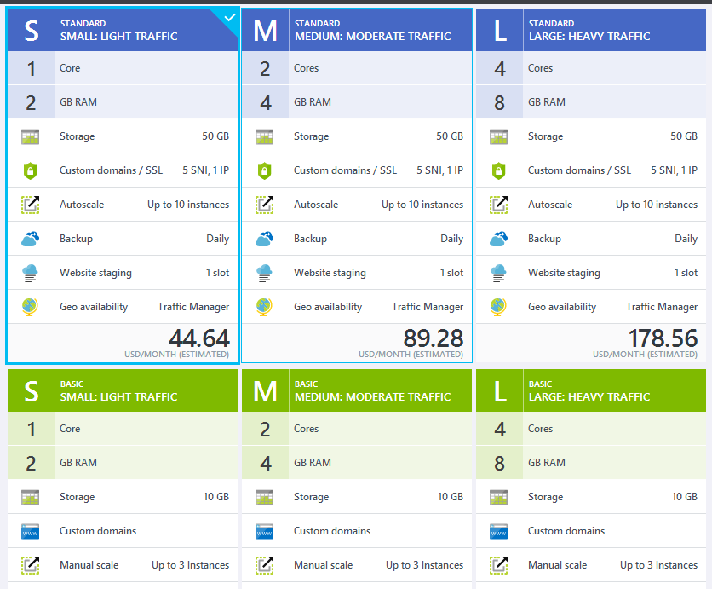
Scaling Setup
Requires Standard to
auto-scale

Slide 23
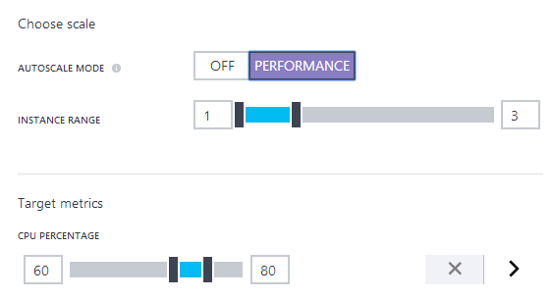
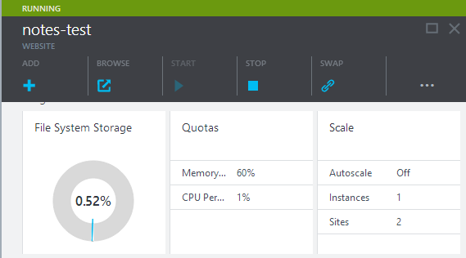
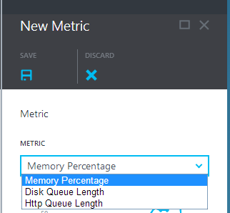
Scaling Setup
CLI:
azure site scale mode
azure site scale instances

Slide 24
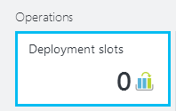
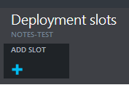
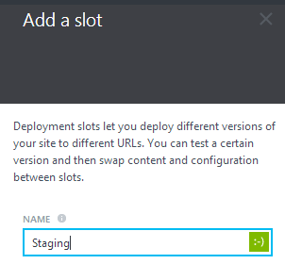
Staged Deployment
Git:
git branch staging
git checkout staging
CLI:
azure site deployment github

Slide 25
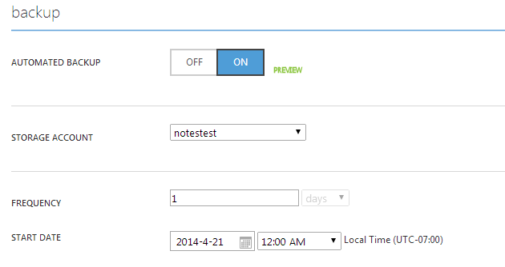

Backup / Restore

Slide 26
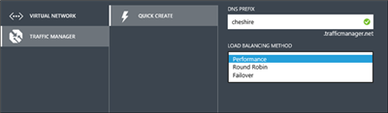
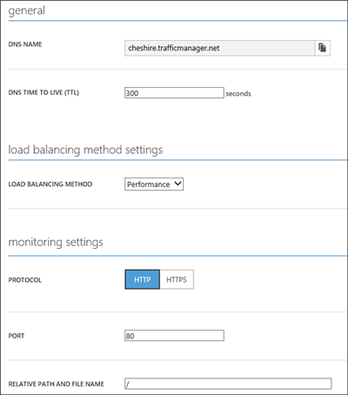
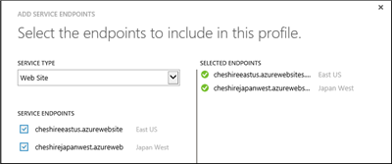
Traffic Manager
Credit: Azure Team Blog

Slide 27
Thank You!
Aidan Ryan
Solutions Architect
AidanR@magenic.com
@ajryan
https://github.com/ajryan/notes-test

